Slide 1
Native Americans
OF
South Carolina

Slide 2
Eastern Woodlands Tribal Groups
Yemassee
Catawba
Cherokee

Slide 3
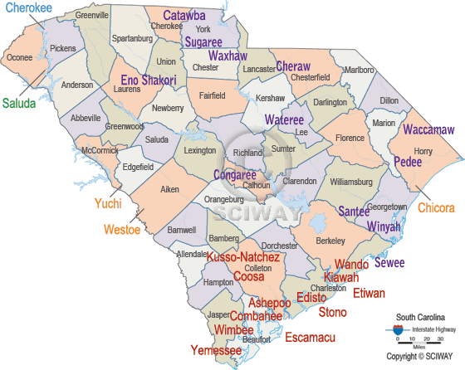

Slide 4
Eastern Woodland Tribal Group
Named this because they were Forest Dwellers.
South Carolina tribes shared the Algonquin language.
Preserved their history through the oral tradition of storytelling.
Settled into more permanent villages than their nomadic ancestors.
They would cut trees and burn brush to create farmland and drive out animals (Slash and Burn agriculture).

Slide 5
They worked the land together, they DID NOT BELIEVE IN PRIVATE OWNERSHIP OF LAND.
They used tree trunks to build canoes for transportation down the rivers and fishing.
Housing was made from tree bark and animal hides and some had log cabins.
They used wood, rocks, and animal pelts to make tools for hunting and farming.

Slide 6
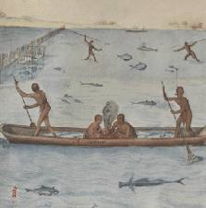

Slide 7
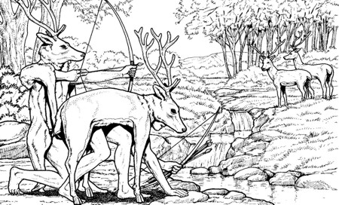

Slide 8
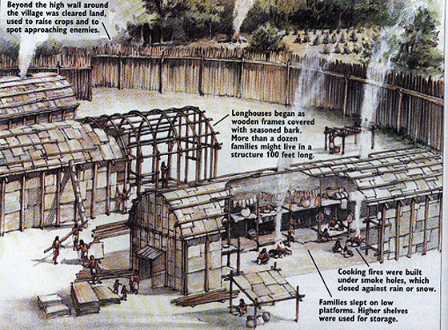

Slide 9
Catawba
Mostly lived in the Piedmont Region
Called themselves the “River People”
Lived in wigwams made of sapling frames with bark.
Council houses where leaders made the rules for the people.
Great potters

Slide 10
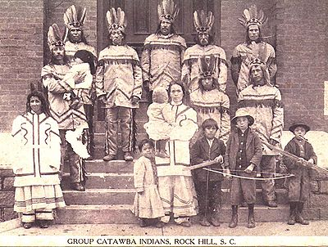
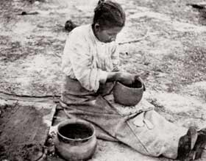
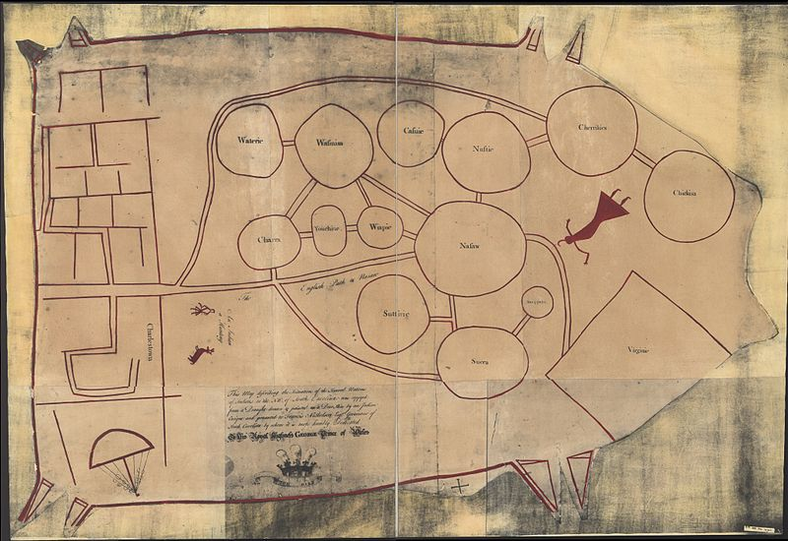
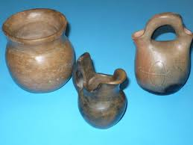

Slide 11
Cherokee
Mostly lived in the Foothills and Mountains of South Carolina.
Call themselves “The Real People” and were a powerful nation.
Lived in Villages of 600 people
Leaders of the village would meet as a council to make rules for the nation.
Each Village had a holy man or woman known as a shaman who was a healer and religious leader.

Slide 12
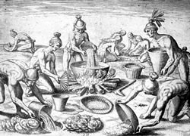
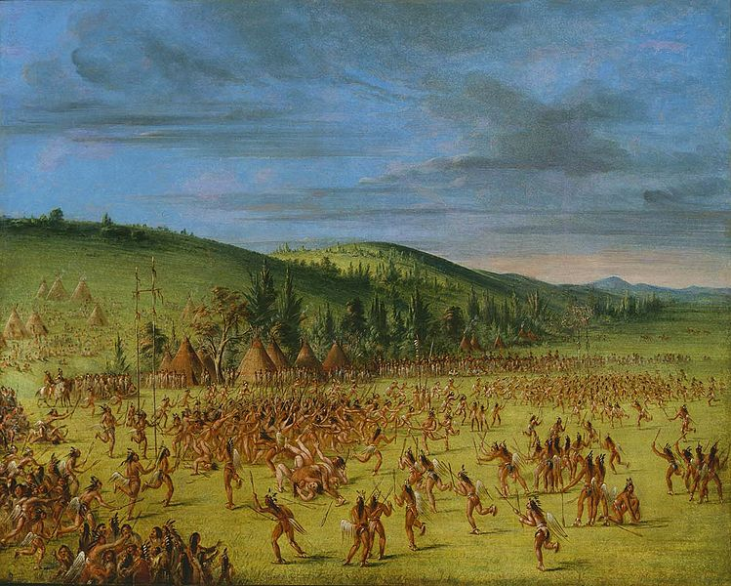
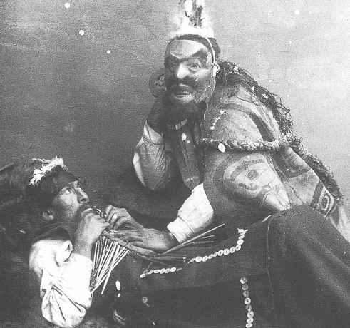

Slide 13
Yemassee
Mostly lived along the coast near the mouth of the Savannah River.
Escaped to South Carolina to get away from the Spanish Governor.
The Yemassee council also included women.
The Yemassee fled Florida after the Yemassee War with the settlers.

Slide 14
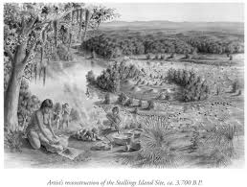
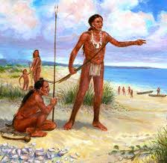
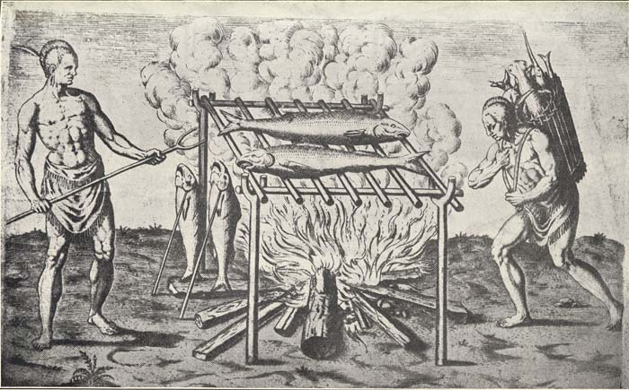

Slide 15
Europeans Arrived
The Eastern Woodland Native Americans traded furs and deerskins for iron tools, and weapons.
Took over many acres of Native American land
Cheated Native Americans in trade
Forced some of the natives into slavery

