Slide 1
What we did Yesterday?
What is the difference between Nationalism and Sectionalism?
What two political parties dominated South Carolina in the early 1800’s?
What was the Missouri Compromise?
What is Mud-Slinging?
What is Treason ?
Notes:
What two crops were effected most by the Embargo Act?
A War Hawk is?
Andrew Jackson’s nickname was?
This Treaty ended the War of 1812?
Who was allowed to vote in South Carolina?
This place was a favorite destination for runaway slaves?

Slide 2
What we did Yesterday?
What is Mud-Slinging?
What is Treason?
What is a Protective tariff?
What was the Missouri Compromise?
What was an Overseer?
During The Nullification Crisis what two political parties were in South Carolina?

Slide 3
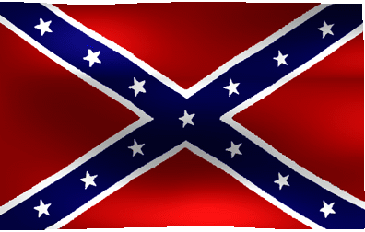
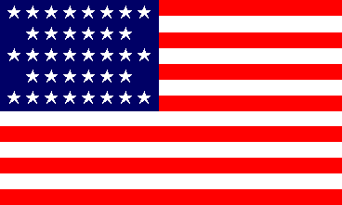
Pre Civil-War
Nationalism vs. Sectionalism
South vs. North

Slide 4
Sectionalism
Loyalty to a particular region or section of the country instead of the nation as a whole.
South
Largely agricultural and grew cash crops like Cotton, Rice, and Tobacco.
There were few Factories, and immigrants
No federal regulations or interference
For Slavery
North
Soil was rich but rocky
Relied on trade, shipping, and eventually industry
Had to regulate immigration, finance transportation, protect industry from inexpensive foreign imports.
Against Slavery

Slide 5
Missouri Compromise
In 1819, there were 22 states, 11 were free states, and 11 were slave states.
A free state was one that did not permit slavery.
A Slave state was one that did permit slavery.
Missouri entered the Union as a slave state while Maine entered as a Free State.
The second part of the compromise, a line was drawn westward from Missouri’s southern border at 36’ 30’north latitude

Slide 6
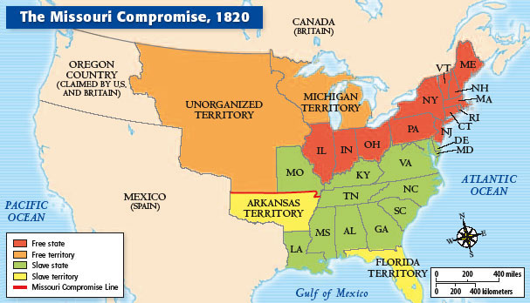
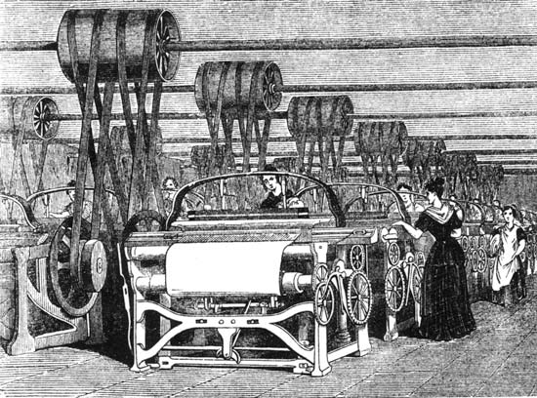
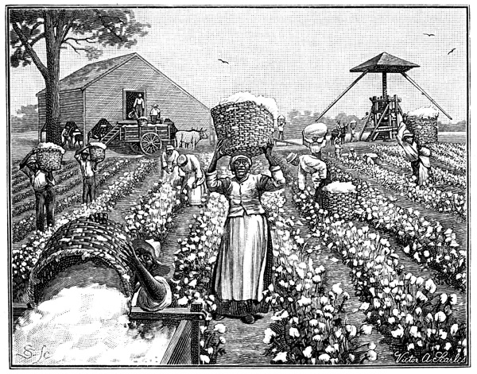
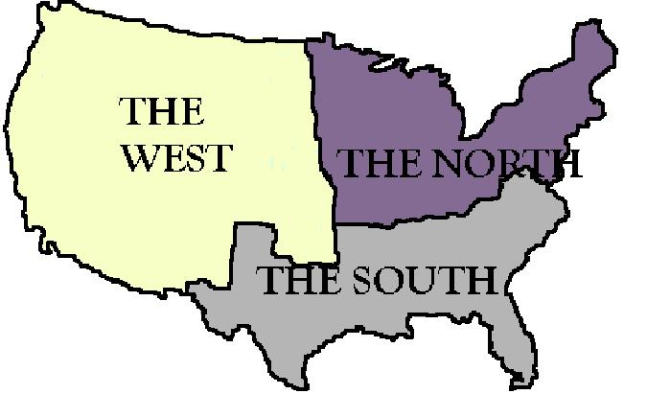

Slide 7
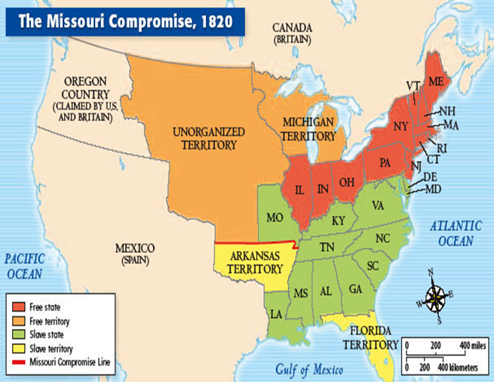

Slide 8
Election of 1824
South Carolina
Nominated William Lowndes instead of Calhoun
Worried about the continued decline in cotton prices 1818=31 cents vs. 1823=12 cents
Slave revolts (Denmark Vesey)
Individuals were nominated by state legislature or Congressional Caucuses.
Any political group organized to further a special interest or cause.
John C. Calhoun, Henry Clay, Andrew Jackson, John Quincy Adams, and William H. Crawford
No candidate received majority of the electoral votes, so the House of Representatives decided the election

Slide 9
John Quincy Adams was elected President and Calhoun his VP.
Jackson began campaigning for the 1828 election
John Quincy Adams and Henry Clay
National Republicans
Andrew Jackson
Democratic-Republicans(Democrats)
Champion of the “common man”
Mud-Slinging- attacking the other candidate and trying to damage the persons reputation.
In 1828 Jackson would defeat Adams in the presidential election.
The Democratic Party became the party of the common man.

Slide 10
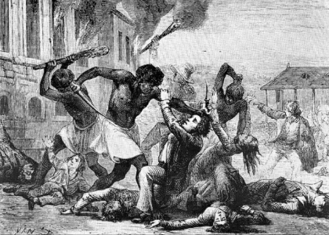
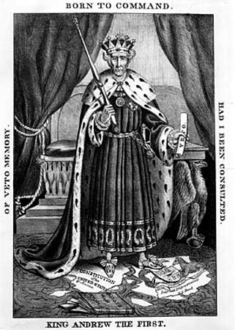
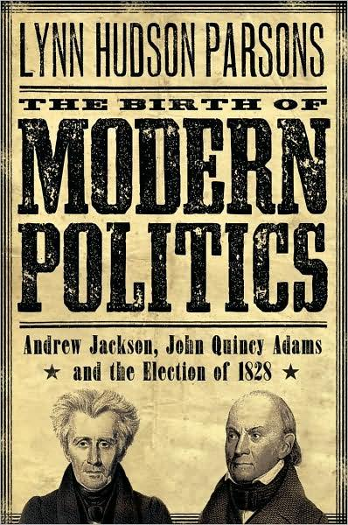
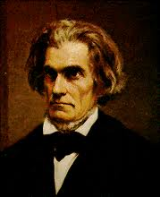

Slide 11
The Nullification Crisis
Protective tariff- A tax raise on imported goods coming from foreign countries in order to make them more expensive than United States goods.
John C. Calhoun
Anonymously wrote South Carolina Exposition and Protest pamphlet.
Claimed it was a state’s right to declare such a law unconstitutional and nullify it through a special state convention.
Threatened the exclusive right of the Supreme Court to decide whether or not an act of Congress was constitutional.
Calhoun would resign as VP in 1832 to return to Congress as a Senator for South Carolina.

Slide 12
Andrew Jackson
Not in favor of nullification
Force Bill- Authorize the National government to send troops to collect the tariff in South Carolina.
Called the act of nullification Treason- A crime of trying to overthrow the government of one’s state or country
South Carolina
States’ Rights Party (Nullifiers)- They were in favor of Nullification
Union Party (Unionists)- They were opposed to the idea
The Nullifiers won a majority of seats in both houses
Congress lowered the tariff and South Carolina repealed its nullification of it
Secession
Allowed states to leave the United States if they believed that their rights were being infringed upon.
States were more powerful than the United States.
These theories would be tested and disproven by Civil War.

Slide 13
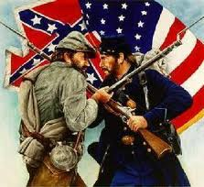
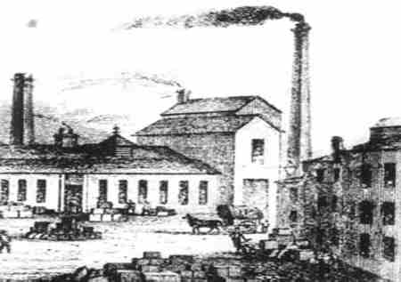
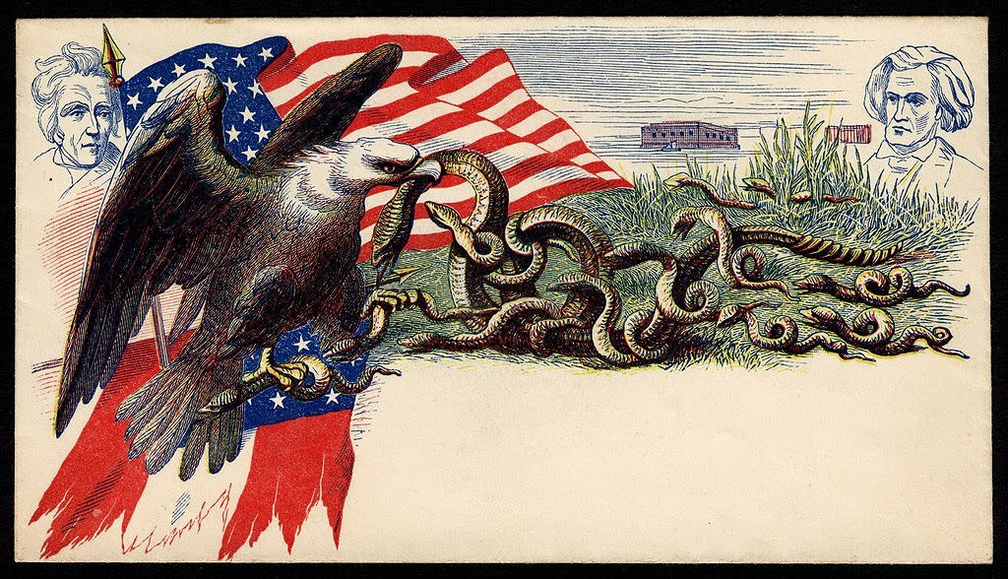

Slide 14
Slavery during Antebellum
Antebellum- The period before the Civil War between the 1820’s and 1860’s.
Slavery
Men
Worked in the fields
Cleared land without the use of modern tools, cut down trees, cleared vines and underbrush, repaired ditches
Women
Worked in the fields
Sewing, weaving, preparing food, minding the children
Children
Kept chickens out of the garden
Fanned flies off the table
Carried water to workers in the field
Gathered nuts and berries
Collected kindling for fires.

Slide 15
Overseer- A person who was responsible for seeing that slaves performed the tasks assigned to them.
Clothing- Issued twice a year in the spring and fall.
Housing- Lived in small cabins with dirt floors not far from plantation owner’s home. They were usually poorly built with inferior materials.
Rice- Each slave was expected to produce four to five barrels of rice each season.
Cotton
Picked by hand
Some times multiple pickings in a season because cotton ripens gradually.
“Ginned” and packed into bales for shipping.

Slide 16
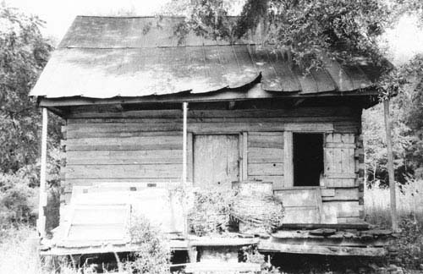
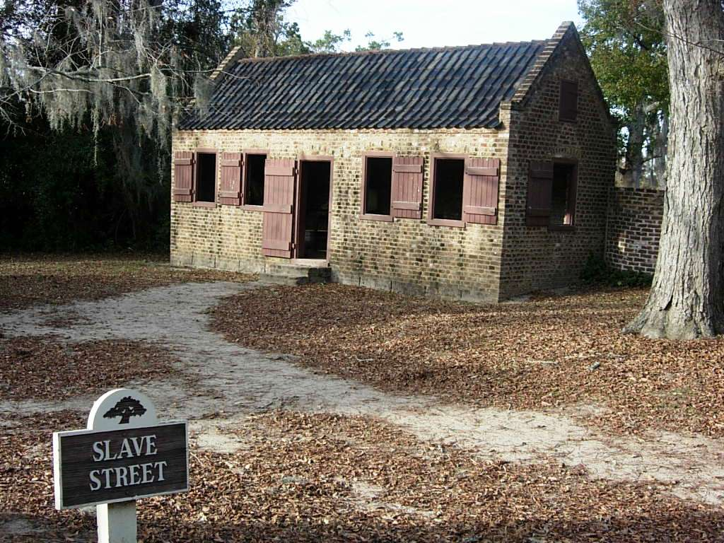
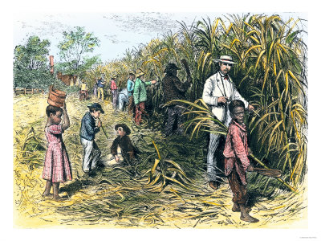

Slide 17
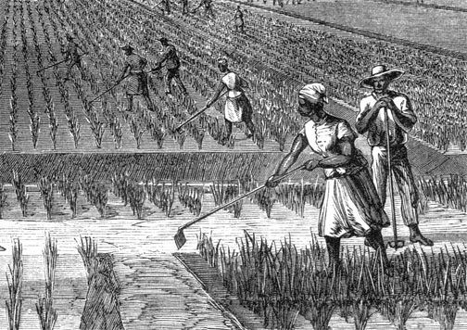
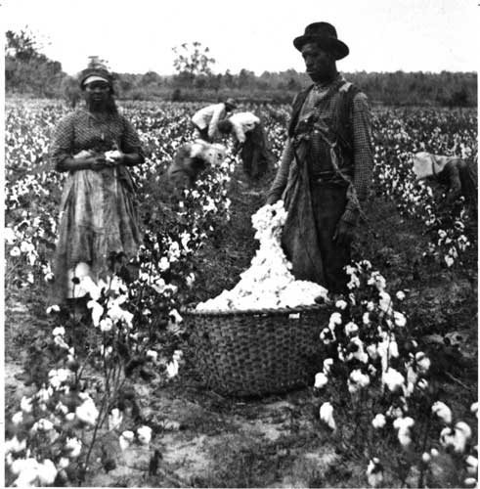

Slide 18
Free African-Americans
Pre-American Revolution
There were few African Americans in South Carolina.
Masters were forbidden to free their slaves, although many did so in their wills.
A mother’s legal status determined her children’s status at the time of birth.
Post American Revolution
Worked as farmers, laborers, and tradesmen
Free blacks suffered from Discrimination- Occurs when people are denied their rights or treated unfairly.
William Ellison
One of the most successful free blacks in South Carolina
Learned how to make cotton gins and bought his freedom in 1816 at the age of 26.
In 1860 he owned 900 acres of land, 63 slaves, and a large house.
1 of 1,646 South Carolinians who owned more than 50 slaves.

Slide 19
William Ellison
When war broke out in 1861, William became a very devout supporter of the Confederacy.
William turned his plantation over from being a cotton cash crop to farming foodstuff for the Confederacy when his grandson joined a Confederate Artillery Unit.
After Ellison’s death on December 5, 1861, per his wishes, his family actively supported the Confederacy throughout the war.
The Ellison family contributed large amounts of money, paid $5000 in taxes, and invested a good portion of their fortune into Confederate Bonds, worthless at the end of the war.
Undoubtedly, the greatest accomplishment of William Ellison was his transitioning from a slave to an entrepreneur.

Slide 20
Abolitionist
People who wanted to abolish or end slavery.
Abolitionists manned the Underground Railroad and had limited impact in South Carolina since the state was too far from a “free states” to make this escape route effective.
Abolitionism grew in the North, and was effective in South Carolina only in making slave owners more determined to hold onto slavery.
Angelina and Sarah Grimke of Charleston
Abolitionist literature printed in the North were kept out of South Carolina by postal workers.
Uncle Tom’s Cabin was condemned as false

Slide 21
Slave revolts
As the number of slaves increased, fears of revolts increased.
Slaves were constantly monitored to ensure that they did not run away.
Majority of slaves were forced to confine their protests to work slow downs, destruction of the master’s property, and feigned illnesses created extended family ties and found some solace in religion.
Denmark Vesey
Suspected of leading a large slave revolt in Charleston during 1822.
Said that he had over 9,000 followers who were secretly armed with daggers and stolen pistols.
A slave named Peter Prioleau told his owner about the plot.
Led to the arrest of over 117 African-Americans free and slave, 35 were banished from the state, 34 were hanged including Vesey.

Slide 22
Nat Turner
Most famous slave revolt in America
Led a band of African-Americans with guns and axes on a killing spree in Virginia
Killed more than 50 white men, women, and children before being put down.
Over 100 slaves were executed for taking part in the plot.
The revolt reinforced the fear white southerners held concerning slaves.

Slide 23
Discussion Questions
What were some of the restrictions placed on slaves and free blacks to reduce the chance of a slave revolt?
What do you suppose the slaves and free blacks did to counteract those measures?
Why do you think there were so few slave uprisings in the South?
Why was slavery accepted in South Carolina during this time?
How did they justify slavery?

Slide 24
