Slide 1
What We Did Yesterday
What two ways could Slaves gain their Freedom?
Free Africans had how long to leave South Carolina or be re-enslaved and sold at auction.
Why was South Carolina considered an unhealthy Colony?
Negro Act of 1740 was also known as?
This language was developed in the Sea Islands off the coasts of South Carolina and Georgia?
Notes:
These people were granted South Carolina by the King of England
The first boom town in America was
Where did the first African Slaves come from
West Africa was also known as?
The Mid-Atlantic Colonies were settled for what purpose
What three groups made up the Grand Council

Slide 2
Free and Enslaved Africans
Role in developing Economy
And Culture in The South
and South Carolina

Slide 3
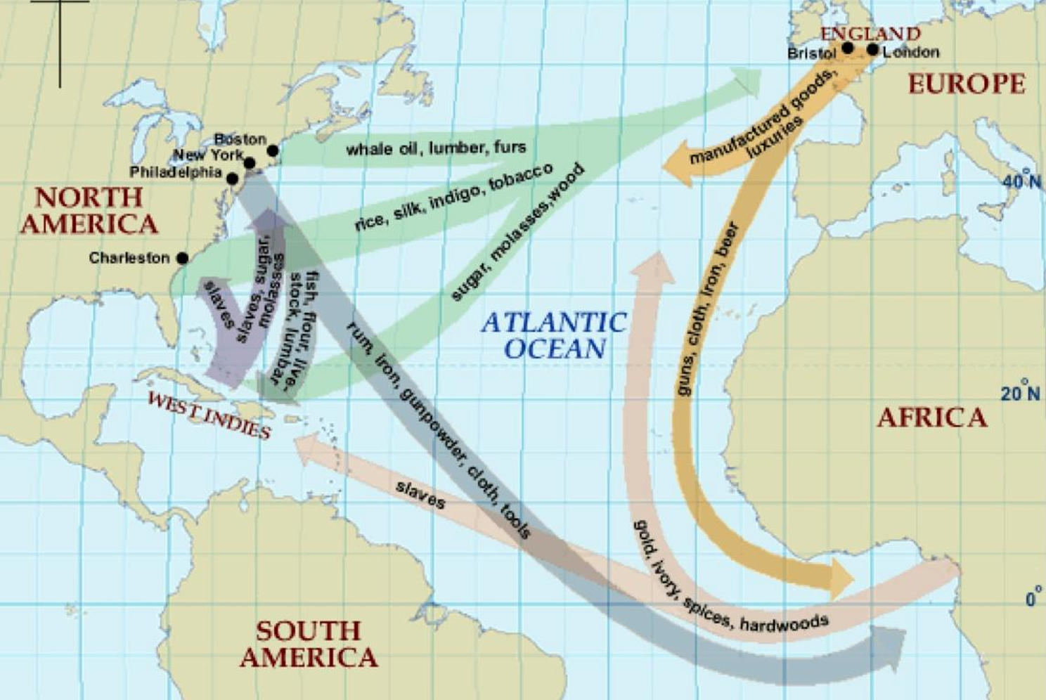
Triangle Trade

Slide 4
Enslaved Africans
The economy of South Carolina was largely based on the plantation system.
75% of the population in South Carolina were slaves.
In the 1690’s thousands of African slaves were brought into South Carolina and the other Southern colonies through the port of Charleston.
Because fewer people wanted to become indentured servants an increase in slaves were needed.
Also, the development of cash crops such as rice and indigo led to the need of more workers.

Slide 5
Slaves were forced through the “Middle Passage” from the west coast of Africa and sold on the auction block.
They brought with them the knowledge of how to cultivate rice and tend to the cattle.
Slaves brought over their African culture from West Africa such as language, dance, music, woodcarving , folk medicine, and basket weaving.
Used drums to communicate with slaves on other plantations until they were banned by fearful whites after the Stono Rebellion.

Slide 6
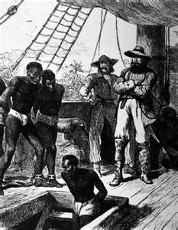

Slide 7
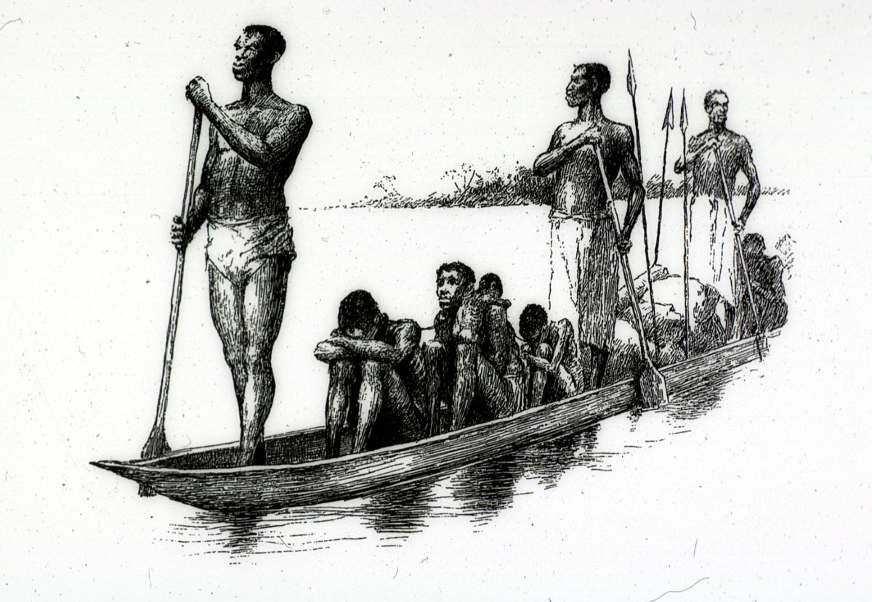

Slide 8
Stono Rebellion
A slave revolt that took place near Charles Town.
Many slaves died within three years of arriving in the colony.
A small group of slaves, broke into a store on the Stono River and killed two settlers while trying to escape to St. Augustine, Florida where the Spanish said they would be free.
Used their drums to summon more slaves to join them.
In the end, more than twenty white settlers and at least forty slaves were dead.

Slide 9
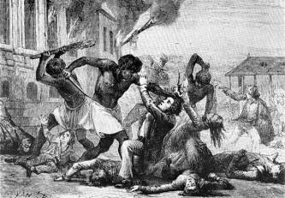

Slide 10
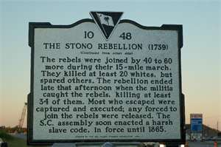

Slide 11
Negro Act of 1740
Also known as the “Slave Codes.”
It established tighter control of the slaves by their owners.
Set penalties for slave owners who were cruel or too demanding.
Prohibited slaves from gathering without white supervision, learning to read and write, and carrying guns.
Created harsher punishments for disobeying the law.

Slide 12
Established a “slave patrol” to check on the location and activities of slaves.
The existence of slavery in South Carolina was a sharp contrast to the freedom many settlers sought in coming to America.
Some Slave owners broke the law by teaching the slaves how to read the Bible.
Some owners allowed Slaves who were carpenters or other craftsman to earn money on the side.

Slide 13
Free Africans
South Carolina had fewer free African-Americans than the other colonies.
Some slave owners freed their slave mistresses with their children and some because of faithful service.
Slaves were also able to purchase their freedom.
Free Africans were required by law to leave South Carolina within six months or be re-enslaved and sold at auction.
4% free blacks lived in the South and were more likely to live in urban areas where they were able to earn a living by their craft.

Slide 14
African Food in The South
Rice
Okra
black-eyed peas
Yams
Kidney and Lima beans.
Watermelon
Over time, these foods found their way into American footways and became a basic component of southern cuisine.

Slide 15
Diseases in South Carolina
South Carolina was an unhealthy colony.
Malaria and Yellow Fever were transmitted by mosquitoes.
Malaria was usually not fatal unless victim was very young or old.
Could lead to measles, whooping cough or dysentery.
African slaves appeared immune to malaria and yellow fever through the sickle-cell trait.
Everyone was susceptible to smallpox, influenza, and typhus.
Cherokee Native Americans started a smallpox epidemic that cost 700 Charleston residents and over 1/3 of the Cherokees.

Slide 16
Gullah
A spoken language and culture of Africans that developed in the Sea Islands off the coasts of South Carolina and Georgia.
Most of the Gullahs' early ancestors in the United States were brought to South Carolina and Georgia through the ports of Charleston and Savannah as slaves.
African farmers from the "Rice Coast" brought the skills for cultivation and tidal irrigation that made rice one of the most successful industries in early America.
They speak an English-based creole language containing many African words and significant influences from African languages in grammar and sentence structure.

Slide 17
Video Clips
http://www.youtube.com/watch?v=11ks526JV70
(Stono Rebellion)
http://www.youtube.com/watch?v=ApecpIAWKYU&playnext=1&list=PL843ED3712F39829D&feature=results_main
Olaudah Equiano
https://www.youtube.com/watch?v=9_O3TWFFmoM

