Slide 1
Diseases

Slide 2
Two types of disease
Infectious
Noninfectious

Slide 3
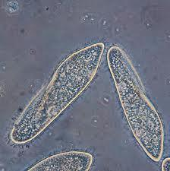
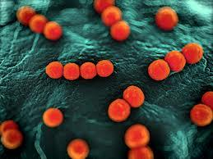
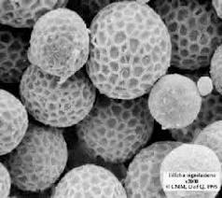
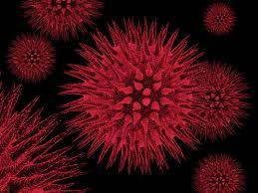
Infectious Disease
Caused by tiny organisms called pathogens.
These pathogens can be bacteria, viruses, fungi, or protists.
These pathogens can come from another person, a contaminated object, an animal bite, or the environment.

Slide 4
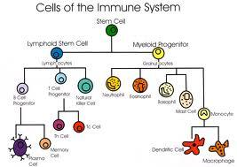
The immune system is responsible for distinguishing between the different kinds of pathogens and reacting to each according to its type.
Once a pathogen has entered the body, it works by damaging individual cells within the organs or in some cases attacks an entire body system.

Slide 5
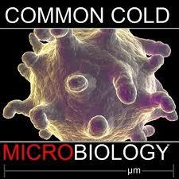
Colds
An illness caused by a viral infection located in the respiratory system.
Once inside the human body, the cold virus multiplies and attacks the mucous membranes of the nose and throat causing the common effects of the cold (for example, sore throat, runny nose or fever).
Because the cold is caused by a virus it cannot be treated with an antibiotic.

Slide 6
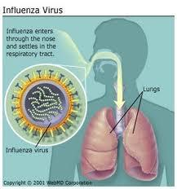
Flu
Influenza, commonly known as "the flu," is a highly contagious viral infection of the respiratory system.
Influenza typically causes fever, muscle aches, and a more severe cough than the common cold and usually lasts longer.

Slide 7
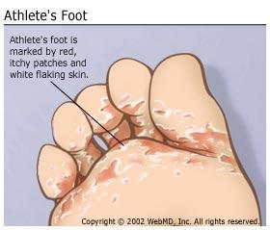
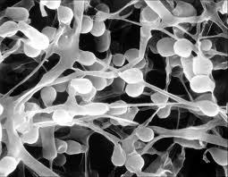
Athlete’s Foot
A common fungal infection of the skin of the feet.
The fungus may be contracted from public environments and then grows in the warm and moist environment usually between the toes, and can be difficult to cure.

Slide 8
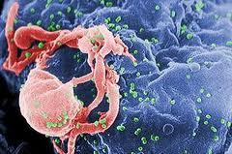
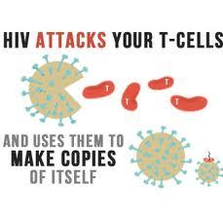
AIDS
Acquired immunodeficiency syndrome (AIDS) is caused by the human immunodeficiency virus (HIV).
This virus attacks the cells in the immune system making the organism unable to fight off other pathogens that may attack the body.

Slide 9
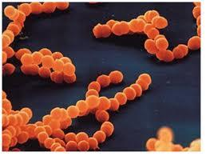
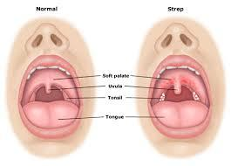
Strep Throat
Strep throat is a contagious disease caused by bacterial infection.
Strep throat symptoms include fever, pain, redness, and swelling of the throat and tonsils.
Strep throat may produce mild or severe symptoms.

Slide 10
Noninfectious Disease
NOT caused by pathogens in the body.
They are not spread from organism to organism.
These diseases are caused by malfunctions in body systems that are either inherited or caused by environmental factors.

Slide 11
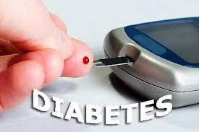
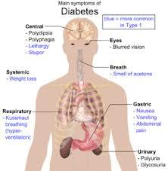
Diabetes
A disease that results in the glucose (sugar) level of the blood being higher than the normal range.
It is caused by a person’s inability to either produce or use properly a natural chemical produced in the body called insulin.
The higher level of blood sugar results in many disorders of the body, for example an increase in problems with circulation of blood.
Diabetes can lead to kidney disease or heart disease or cause vision problems.

Slide 12
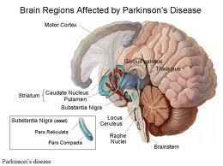
Parkinson’s disease
A disease of the nervous system that occurs when certain nerve cells in the brain stop functioning properly, affecting the muscular system.
The major symptoms are severe shaking (tremors) and disabilities involving movement.
At present, there is no cure for Parkinson's disease.

Slide 13
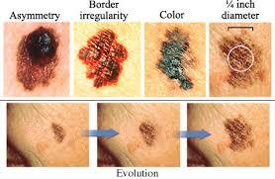
Skin Cancer
A disease in which skin cells found in the outer layers of the skin becomes damaged.
Factors that can lead to skin cancer are damaging ultraviolet rays (UV) from the Sun or tanning beds and heredity.

Slide 14
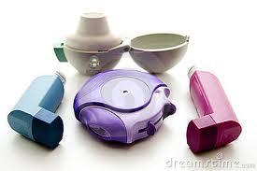
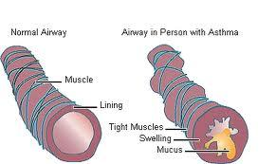
Asthma
Asthma is a disease that affects the lungs and the airways that deliver air to the lungs.
It causes periodic attacks of wheezing and difficulty breathing.
An asthma attack occurs when the airways become inflamed in response to a stimulus, such as dust, mold, pets, exercise, or cold weather.
However, some attacks start for no apparent reason.

