Slide 1
What we did Yesterday??
Smugglers were prosecuted in this type of court system which did not use juries?
What did the First Continental Congress establish?
This famous saying came about because of the “Stamp Act”?
An import tax on paint, paper, tea, and a variety of other goods?
The Tea Act gave exclusive rights to this company to sell tea in the colonies?
The First Continental Congress took place here?
Notes:
This treaty ended the French and Indian war?
What did they call the “French and Indian War” in England?
What’s the name of the French fort built near present day Pittsburgh?
This treaty ended the war between the English and Cherokee?
What did England get out of the treaty?
How did the Sugar Act effect South Carolina?
Whay was the French and Indian War Started?
In what way was South Carolina effected by the French and Indian War?

Slide 3
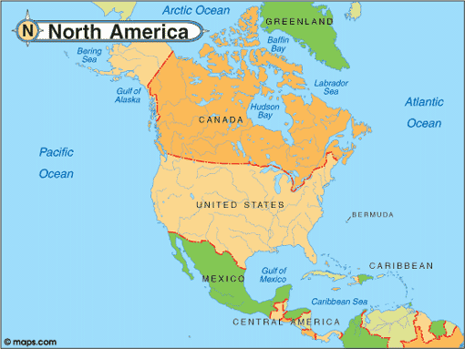

Slide 4
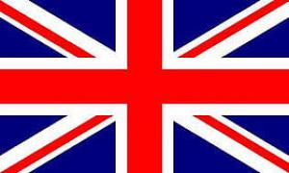
Consequences of the
French and Indian War

Slide 5
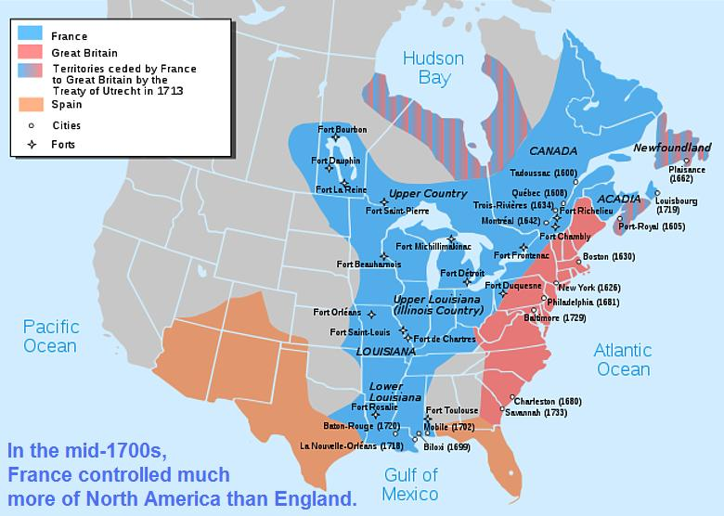

Slide 6
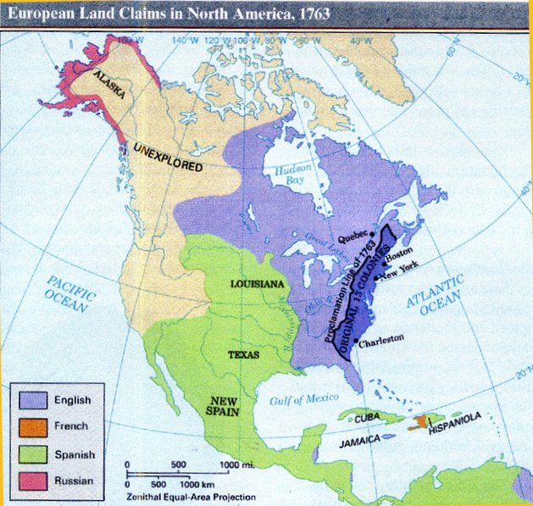

Slide 7
French and Indian War
Also, known as the “Seven Year War”
Started because both claimed land west of the Appalachian Mountains known as the Ohio Valley.
In 1753, the French built Fort Duquesne near present-day Pittsburgh.
The Virginia governor sent Colonel George Washington and a small band of militia to build a fort to protect Virginia called Fort Necessity.

Slide 8
Native American tribes such as the Delaware and Shawnee sided with the French and attacked settlements along the Pennsylvania, Virginia, and New York frontier .
In 1759, the British conquered Quebec, the main French settlement in America and ended the war.
In 1763, the Treaty of Paris was signed that formally ended the war.
France lost her possessions in North America east of the Mississippi River.
The Spanish took control of the land France claimed west of the Mississippi.
Spain lost control of Florida to the British

Slide 9
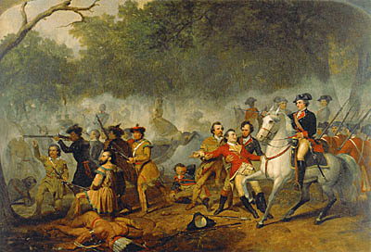
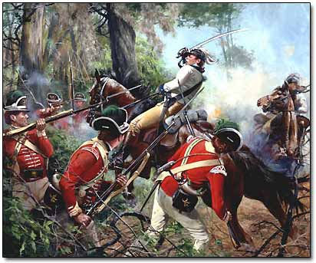

Slide 10
SC Colonist Role in French and Indian War
No battles of the war were fought in South Carolina and few fought in the war.
French fur traders moved to the upstate which caused English settlers to seek a treaty with the Cherokee.
The Cherokee interpreted this treaty as an alliance while the British saw it as an acknowledgement of British Sovereignty.
Peace lasted for 30 years and was broken during the French and Indian War.
British failed to protect the Cherokee when the French and their Indian allies attacked.
Feeling cheated by the British, The Cherokee took possession of horses belonging to settlers, which caused the whites to attack and the Cherokee to retaliate.

Slide 11
The war allowed SC settlers to move farther west and south without fear of Spanish attack.
South Carolina expanded their Indigo trade because British textile manufacturers could not get the blue dye from the French West Indian colonies.
The biggest way it affected South Carolina was, it helped cause the American Revolution.

Slide 12
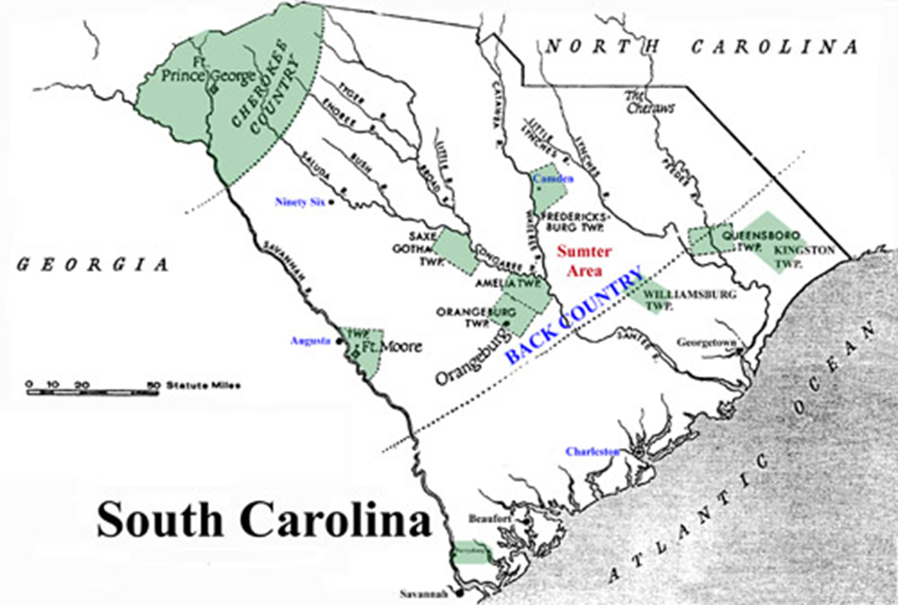

Slide 13
South Carolina vs. Cherokee
Royal Governor of South Carolina tried to control the Cherokee by stopping all trade with them and making hostages of the Cherokee peace emissaries.
In 1759, the Cherokee retaliated by attacking settlements in western South Carolina.
31 Cherokee Chiefs were held hostage until the Native Americans who attacked the settlement were handed over.
Native Americans responded by attacking a nearby settlement and the soldiers killed all of the hostages

Slide 14
The British burned crops and towns of the Native American and didn’t spare anyone.
It lasted for about two years and resulted in many deaths among the Cherokee.
Treaty that ended the war forced the Cherokee to give up much of their land and created a boundary dividing the colony and the Cherokee territory.

Slide 15
South Carolina vs. England
French and Indian War changed the relationship of the colonies with England.
The British attempted to enforce their mercantilist policies.
The Sugar Act was designed to stop illegal trade with France and collect revenues to fund the war effort.
Smugglers were prosecuted in Vice Admiralty Courts which did not use juries.
Colonists acknowledged the right of Parliament to control trade but saw Vice Admiralty courts as a violation of their rights.
Great Britain incurred a significant debt in the French and Indian war that they thought the colonists should pay.

Slide 16
The Stamp Act
This act placed a tax or duty on paper, such as legal documents, newspapers, and playing cards which the colonists paid directly.
Colonists protested “No taxation without representation” because they did not have a representative in Parliament.
Organized a Stamp Act Congress and a boycott on British goods that led to the repeal of the Stamp Act.
In 1765 the Stamp Act Congress met with representatives from nine colonies including South Carolina to discuss how to fight the tax and came up with a non-importation agreement.

Slide 17
This action would hurt British merchants because they would not be able to sell goods to the colonies.
Governor William Bull closed down the port of Charles Town for 4 months and refused to allow any activity to occur in the absence of the stamps.
Later required ships that cleared the port to obtain a permit from the customs collectors and permit cost about the same as a stamp.
In 1766, Parliament repealed the Stamp Act but was in the process of passing other taxes and acts.

Slide 18
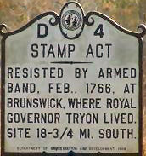
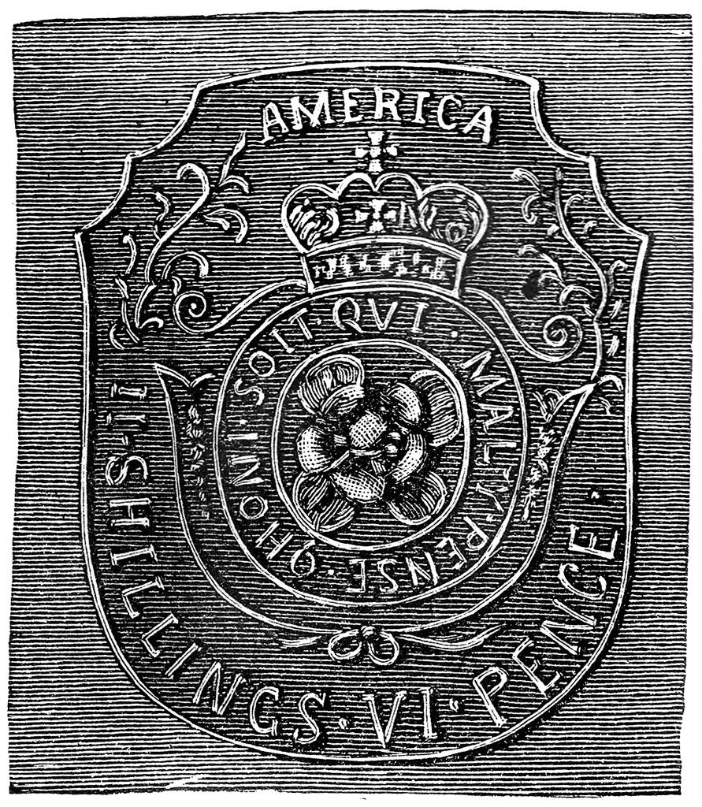

Slide 19
The Townshend Acts
An import tax on paint, paper, tea, and a variety of other goods.
Colonists were unwilling to accept an import tax because it was designed to collect revenue, not to regulate trade.
In South Carolina any merchant who imported goods from Britain was boycotted.
The Townshend duties were later repealed except for the tax on tea.
Henry Laurens who would become an important South Carolina patriot had two ships seized and customs officials and legal officials treated him poorly

Slide 20
The Tea Act
The Tea Act was not a tax
This Act gave the British East India Company exclusive rights to sell tea in the colonies.
Colonists started boycotting because of the tax imposed under the Townshend Acts.
“Sons of Liberty” feared that the availability of cheap tea would threaten the effectiveness of the boycott.
In Boston they dressed up as Native Americans and stormed the ships dumping the tea overboard.
Georgetown and Charlestown had small “tea parties” where they threw the tea overboard.

Slide 21
The Boston Tea Party resulted in Parliament’s passage of what the colonists called the Intolerable Acts.
The British punished the residents of Boston because of the tea party
Closed Boston harbor to shipping
Changed the political structure of Massachusetts by making the legislature an appointed body
Suspended most town meetings
Ordered that any royal official charged with a crime be sent back to Great Britain for a trial
South Carolinians realized that if the British government could take these actions against Massachusetts, it could also happen to them
Colonists sent delegates to a Continental Congress in order to address the problem of the Intolerable Acts.

Slide 22
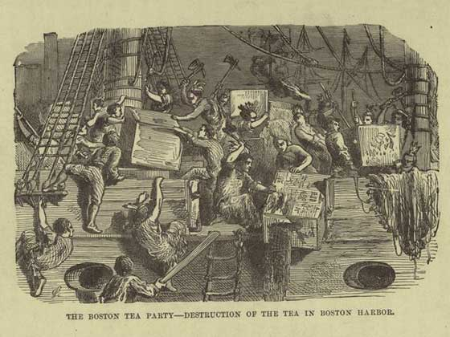
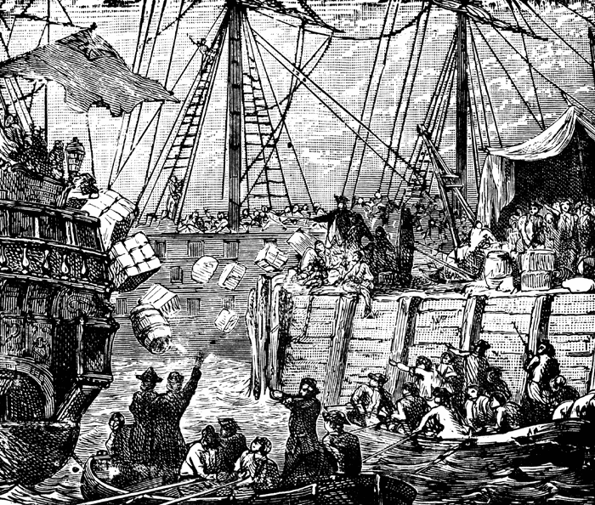

Slide 23
The First Continental Congress
The First Continental Congress was a convention of delegates from twelve colonies that met on September 5, 1774, at Carpenters' Hall in Philadelphia, Pennsylvania.
It was called in response to the passage of the Intolerable Acts by the British Parliament.
In 1774, representatives from across South Carolina met in Charlestown to elect representatives to the Continental Congress.
Representatives of South Carolina at the Continental Congress was John Rutledge, Edward Rutledge, Thomas Lynch, Henry Middleton, and Christopher Gadsden.

Slide 24
Established a General Committee of 99 to govern the colony instead of the royal governor.
Henry Middleton of South Carolina was elected president of the Continental Congress.
Established a non-importation and non-exportation agreement.
South Carolina delegates successfully argued that rice was essential to the survival of their colony, so rice was allowed to be sold to Great Britain.

Slide 25
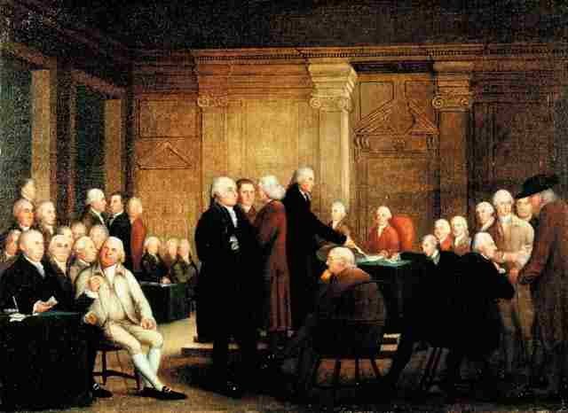
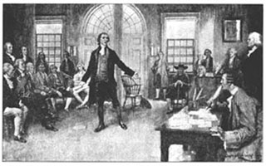

Slide 26
Members of the Continental Congress
Massachusetts
New York
Virginia
South Carolina
John Adams
Sam Adams
John Jay co-wrote The Federalist Papers
Patrick Henry
Benjamin Harrison
George Washington
Henry Middleton
Edward Rutledge
John Rutledge

Slide 27
Sons of Liberty
Along with the “Daughters of Liberty” played a significant role in enforcing the boycotts through persuasion and intimidation.
Daughters of Liberty engaged in spinning bees and refused to buy British products finding substitutes.

Slide 28
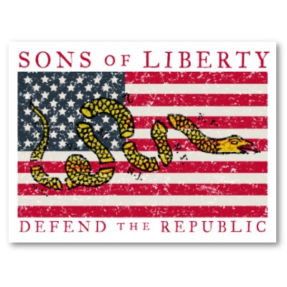
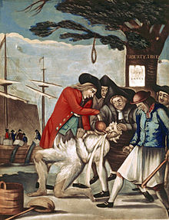
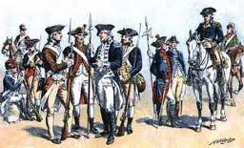

Slide 29
SC Politics
South Carolina political leaders wanted to find a peaceful solution to their issues so they could remain part of the British empire.
One group called themselves patriots
Another group called loyalists or supports of the crown supported the king and Parliament without question.
The last group didn’t care what happened because they had little involvement with the British economic system.
They all wanted to avoid war!!

Slide 30
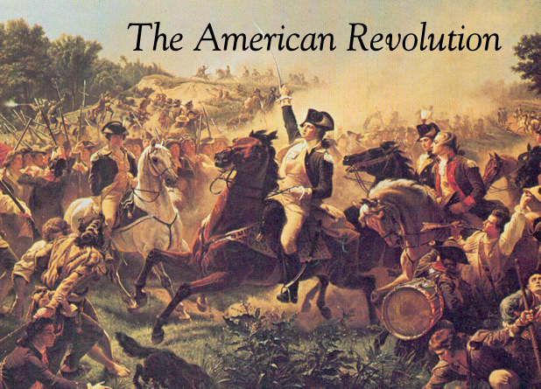

Slide 31
Video Clips
http://www.youtube.com/watch?v=Kmo9oBJJXr8&feature=related
http://www.youtube.com/watch?v=Seack6kqiGk

