Slide 1
How is the human body organized?
DMS 2015

Slide 2
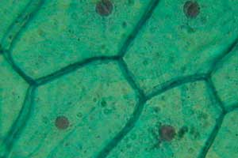
Cells
The basic units of structure and function within the human body.
Though all cells perform the processes that keep humans alive, they also have specialized functions as well.
Examples may be nerve cells (neurons), blood cells, and bone cells.

Slide 3
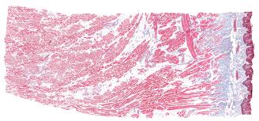
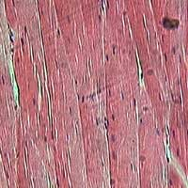
Tissues
A group of specialized cells that work together to perform the same function.
There are four basic types of tissue in the human body

Slide 4
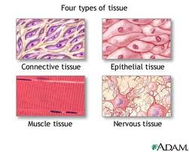
4 types of tissues
  Nerve tissue - carries impulses back and forth to the brain from the body
  Muscle tissue (cardiac, smooth, skeletal) - contracts and shortens, making body parts move
  Epithelial tissue - covers the surfaces of the body, inside (as lining and/or covering of internal organs) and outside (as layer of skin)
  Connective tissue - connects all parts of the body and provides support (for example tendons, ligaments, cartilage)

Slide 5
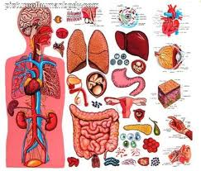
Organs
A group of two or more different types of tissue that work together to perform a specific function.
The task is generally more complex than that of the tissue.
For example, the heart is made of muscle and connective tissues which function to pump blood throughout the body

Slide 6
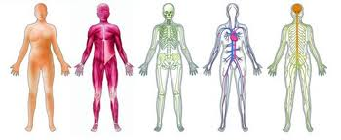
Systems
A group of two or more organs that work together to perform a specific function.
Each organ system has its own function but the systems work together and depend on one another.

Slide 7
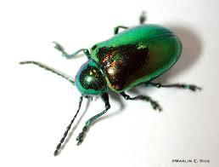

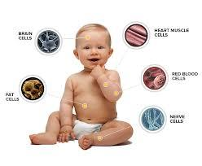

Organisms
A living being that is made up of different systems that work together

Slide 8
11 body systems
There are eleven different organ systems in the human body:
    Circulatory
    Digestive
    Endocrine
    Excretory (urinary)
    Immune
    Integumentary (skin)
    Muscular
    Nervous
    Reproductive
    Respiratory
    Skeletal

Slide 9
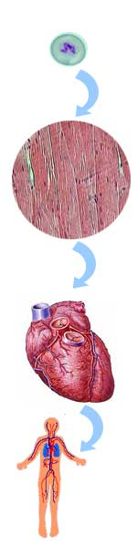
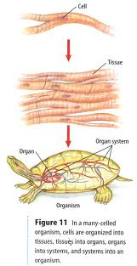
Summary
Cells
Tissue
Organ
System
Organism

Slide 10
Review
What is the smallest and most basic building block of the human body?
What are the four kinds of tissue in the human body?
What do we call a group of different types of tissues working together to perform a special function?

