Slide 1
What we did Yesterday?
What is the difference between a Federalist and Anti-Federalist?
This person came up with the idea for the first National Bank.
Under the New South Carolina Constitution what was the criteria to vote?
What was the 3/5 Compromise?
What was the Great Compromise?
What is the highest law of the United States?
A small farmer who grows only enough crops to feed his or her family
Notes:
What was the Virginia Plan?
The Articles of Confederation established?
What was the 3/5 compromise?
Who became the governor after John Rutledge?
Where was the new Capital of South Carolina to be located?
How many states did it take to approve a new law?
Where did South Carolina’s legislature meet for their General Assembly
Where did many Loyalist go after being forced to leave South Carolina?
How was South Carolinian's economy disrupted?
During the war what did the British do to many South Carolinians
Where did John Lewis Gervais want to establish the New capital of South Carolina.
Who was the first Governor of South Carolina after the American Revolution?
The First Constitution for the United States was known as

Slide 2
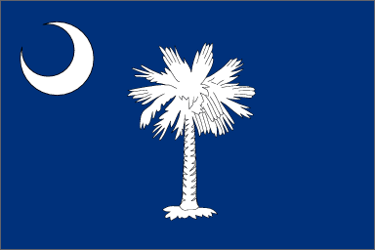
A New State and
National Government

Slide 3
Carolina After the War
In 1782 South Carolina legislature met in Jacksonborough for an assembly.
Met here because the British still occupied Charles Town.
Elected John Mathews as the new governor.
Wanted to Identify individuals who were loyalists during the war
During the war The British exiled many South Carolinians to St. Augustine.
Confiscated the Patriots property
Executed prisoners
Took slaves from plantations.
One act identified 238 individuals whose property was confiscated and the people banished from the state.

Slide 4
Continue
A second act identified 47 individuals whose property was assessed and a 12 percent loyalists penalty was placed on them for their actions.
A third act provided other loyalists with conditional amnesty if they paid a fine of 10 percent of their property value.
Most loyalists left the state when the British withdrew from Charles Town.
Many Loyalists went to the Bahamas or Jamaica in the Caribbean
Some went to Nova Scotia and New Brunswick in Canada.
Many Patriots still held great bitterness towards the Loyalist
Mobs lynched or ran former loyalists out of town
Some former loyalist resumed their places in the elite of Charles Town and retained their wealth.

Slide 5
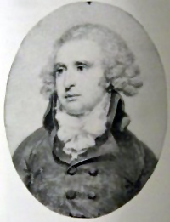
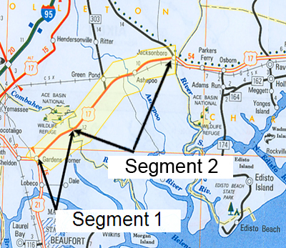
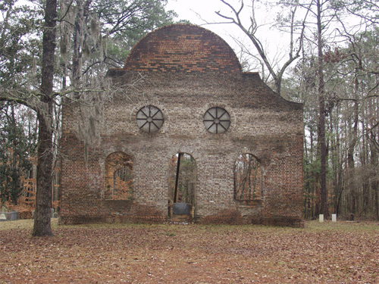
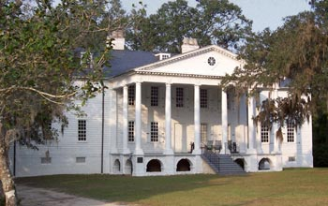

Slide 6
Rebuilding the Economy
During the war, both sides seized food, supplies, and private property from the state’s citizens
Both sides promised they would pay for those goods later, but neither did.
South Carolina economy was disrupted by the war
No more large bonuses from the British Board of Trade for Rice and Indigo.
Planters could only get market price, which meant neither crop was as profitable after the war.
The markets the British provided are gone.
Planters and Merchants had to establish new markets and trade routes.
Many of the fields were damaged during the war and some slaves left with the British.

Slide 7
Continue
South Carolina Assembly tried to help.
Issued paper currency to provide loans to help citizens pay their taxes or rebuild their farms.
Allowed debtors to pay creditors with land instead of cash.
Extended the time period people had to pay back the debts.
Prohibited the foreign slave trade for six years
It took many years for the state to recover from the economic mess the war had left.

Slide 8
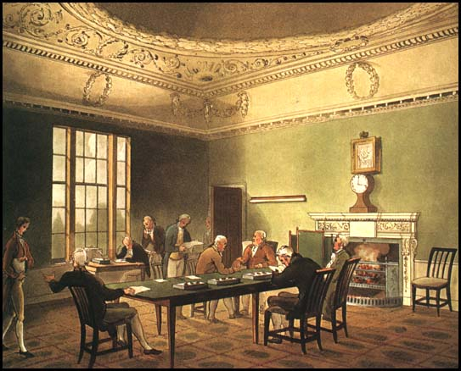
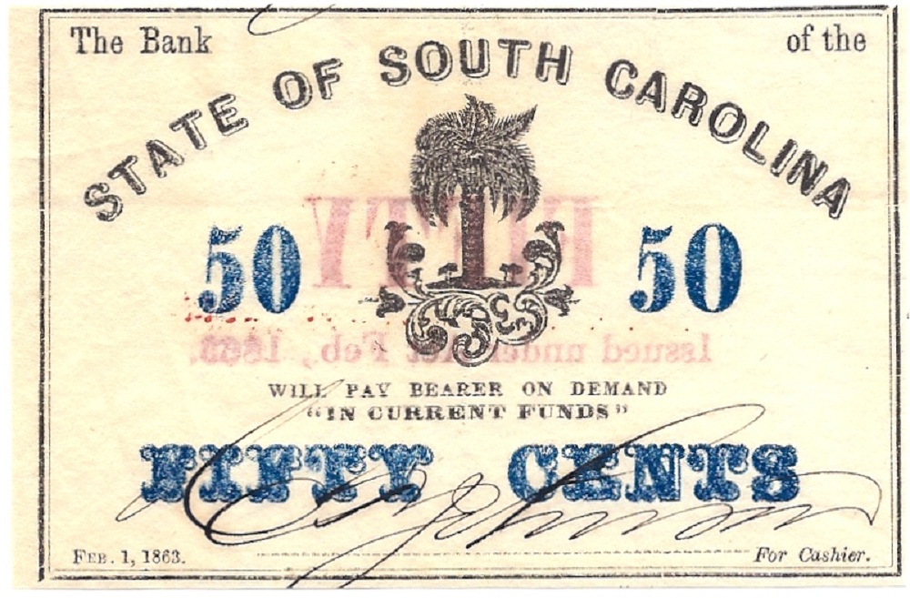

Slide 9
Moving the Capital
The Up Country did not like having to go to Charleston to present issues to the legislature.
John Lewis Gervais introduced a bill to establish the capital near where the Broad and Saluda rivers meet.
The new city was named Columbia
As part of the compromise, the Low Country retained its majority in the legislature

Slide 10
Continue
A new state house was started in Columbia in 1786.
The legislature met for the first time in the new building in 1790.
Charles Town remained important to the life of the state.
Legislature gave them their own town government.
It was renamed Charleston

Slide 11
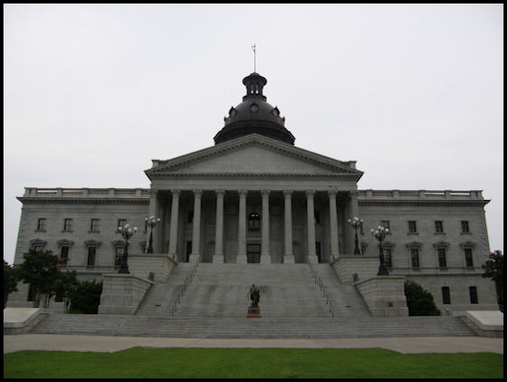
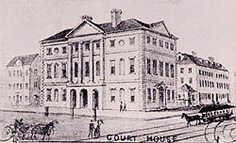

Slide 12
Articles of Confederation
The first constitution for the United States was ratified in 1781.
Established a weak central government.
All power was reserved for the states.
Only government body was Congress
Each state had one vote
No power to raise money through taxes
All major laws required the approval of nine out of the thirteen states
The Articles could be amended only by unanimous vote of the states.

Slide 13
Continue
The Continental Congress was weak
They were unable to pay the soldiers
No power to regulate trade between the states or The United States and foreign countries.
The New Nation and the States had large war debts.
In 1786 a rebellion broke out between “haves” and the “have-nots” known as Shays’ Rebellion.
The states sent delegates to Philadelphia to amend the Articles of Confederation.

Slide 14
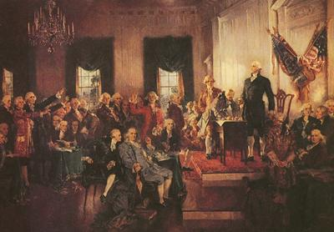
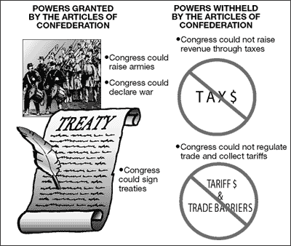
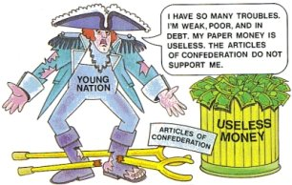

Slide 15
The Constitutional Convention
Sent four delegates to the convention Pierce Butler, Charles Pinckney, Charles Cotesworth Pinckney, and John Rutledge.
Debated whether to amend the Articles of Confederation.
Give the National Government the power to tax and regulate commerce
Create new constitution
Virginia Plan
Legislative, Judicial, and Executive
Wanted representation in Congress to be based on Population.

Slide 16
Continue
New Jersey Plan
Proposed number of representatives from each state be equal.
Great Compromise
The House of Representatives would be based on population.
The Senate would give each state equal representation.
Three-Fifths Compromise
Counted every 5 slaves as 3 for both taxation purposes and population.

Slide 17
Continue
Commerce Compromise
Promised that the federal government would not tax exports.
Would not attempt to regulate the international slave trade for at least twenty years
States determined voter qualifications
Only property owners could hold office

Slide 18
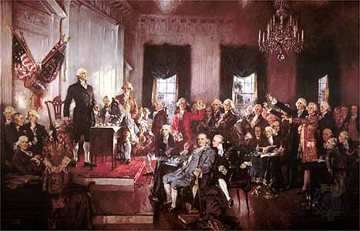
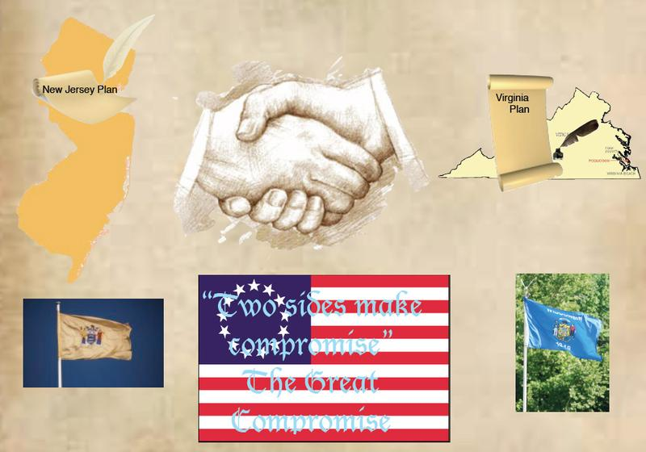
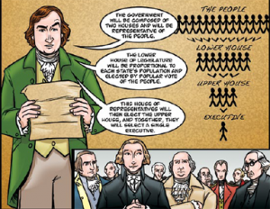

Slide 19
Ratifying the Constitution
9 of 13 states had to ratify the document
South Carolina convention met May of 1788
Antifederalists
Aedanus Burke and Rawlins Lowndes
Opposed the ratification of the constitution
Federalists
Led by Charles Pinckney
Supporters of the document
Insisted that the United States needed a strong government for foreign affairs and establish economic stability.

Slide 20
Continue
South Carolina convention ratified the Constitution 149 to 73
Low Country delegates voted for the document and the Up Country voted against it.
South Carolina was the 8th colony to ratify the Constitution
George Washington was chosen the first president in early 1789.

Slide 21
United States Constitution
Established a limited government based on power shared between the National and State government.
The Bill of Rights provided a written guarantee of individual rights.
Highest law in the United States
Other laws must conform to the Constitution
Each state has its own constitution

Slide 22
Continue
Basic Principles of the American Government
Democracy- (Popular Sovereignty) The authority for government flows from the people.
Individual Rights- Unalienable rights that are guaranteed to all citizens in the Preamble and Bill of Rights.
Federalism - The federal system divides governmental powers between National and State Governments.
Separation of Power- Executive, Legislature, Judicial
Checks and Balances-
Limited Government- Constitution protects the rights of the individual against excessive power by the government
Representative Democracy (Republicanism)- The people hold the power but elect representatives to exercise the power for them.
Most State governments mirror the organization of the National Government

Slide 23
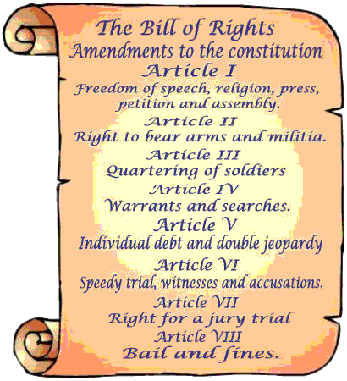
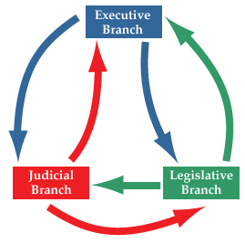

Slide 24
New South Carolina Constitution
South Carolina convention met May 10, 1790.
Determined the number of representatives a county or a district may have in legislature.
Convention reduced the number of members in the lower house
Up Country gained some representation, but majority control stayed with the Low Country.

Slide 25
Continue
Separation of Church and State
Increase in the property requirements to vote and hold office
To vote, a man had to own 50 acres of land
To serve in the lower house
A man had to own 500 acres of land and at least 10 slaves.
To serve in the Upper house
A man had to own 1,000 acres of land and at least 20 slaves
Under the new constitution, the legislature remained the most powerful branch of government

Slide 26
The Early Years of America
The Judiciary Act of 1789
Established the basic court system we have today
Circuit (Lower) Courts were set up in every state
Appeals courts were also set up throughout the country
Established four departments of government that made up the first cabinet
Secretary of War- Henry Knox
Secretary of Treasure- Alexander Hamilton
Secretary of State- Thomas Jefferson
Attorney General- Edmund Randolph
Alexander Hamilton
Thought the National Government should pay its war debts and any remaining debts of the States.
Recommended congress establish a national bank
They would issue money for the government
They could collect taxes
Protective Tariff on imports to keep out foreign competition and help American industries grow.

Slide 27
Continue
Hamilton believed in broad construction of the constitution
If the Constitution did not prohibit an action then Congress could do it.
His supporters became known as Federalists
Jefferson believed in a strict construction of the Constitution
If the Constitution did not specifically say that congress could do something, then Congress could not do it.
His supporters became known as Democratic-Republicans
President Washington sided with Hamilton, and most of his ideas were adopted by Congress

Slide 28
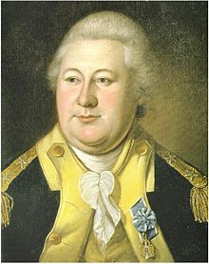
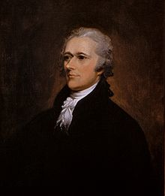
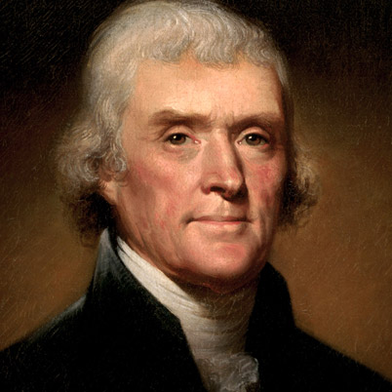
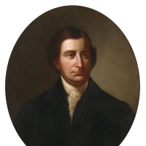

Slide 29
Life in the Low Country
Most of the State’s wealth was in Charleston and the Low Country.
The Lowcountry was dominated by plantations
Economic and Social Status depended on their slave holdings.
Low country had greater representation in the legislature and greater influence in the government.
Charleston residents often hired others to do jobs for them.
Low country planters feared the Upcountry farmers did not support slavery.

Slide 30
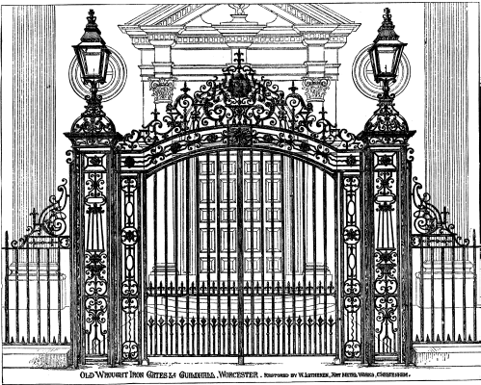
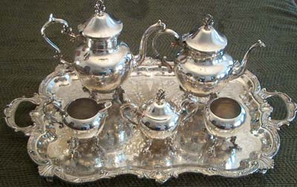

Slide 31
Life in the Up Country
UP Country
Subsistence farmers
A small farmer who grows only enough crops to feed his or her family.
Majority worked their farms without the assistance of slave labor.
Women's work began in the home and moved outward to the garden and pasture.
Men's work began in the pasture and moved to the barn, workshop, across fences to fields, pastures, and woodlands.

Slide 32
Continue
The invention of the Cotton gin made Cotton a viable cash crop.
Greater need for slave labor
More slaves = Increased power in Legislation
Compromise of 1808
Representation was based equally on the white population and the amount of taxable property.
UP country still had less control over legislation than the Low Country.

Slide 33
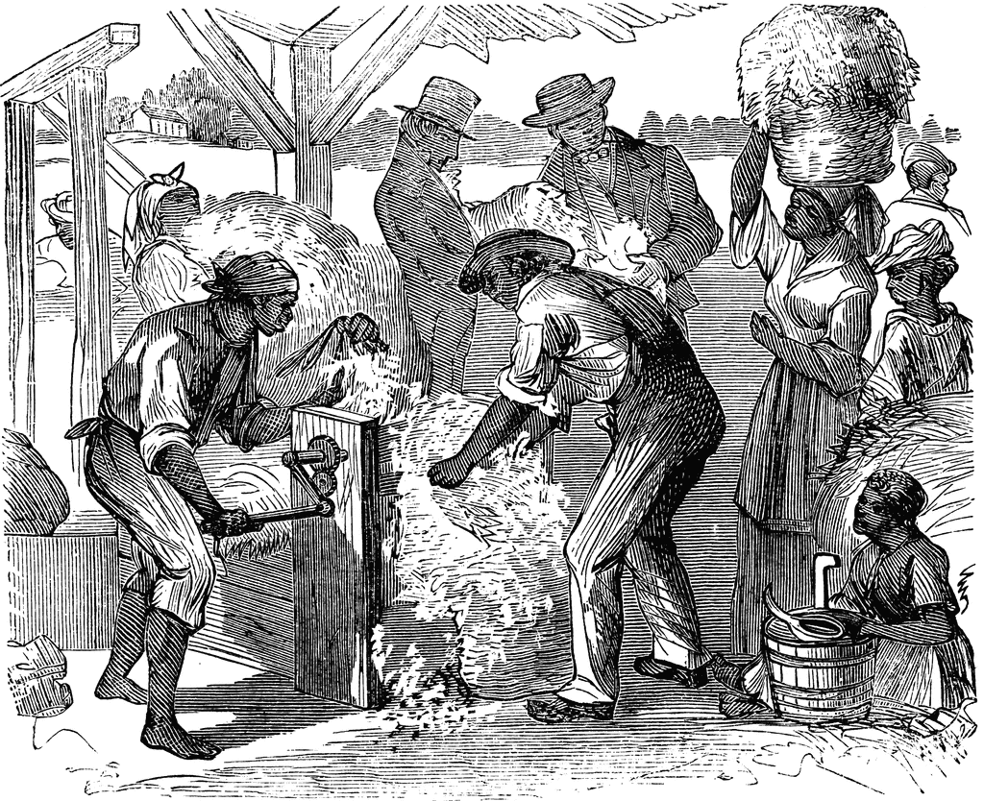
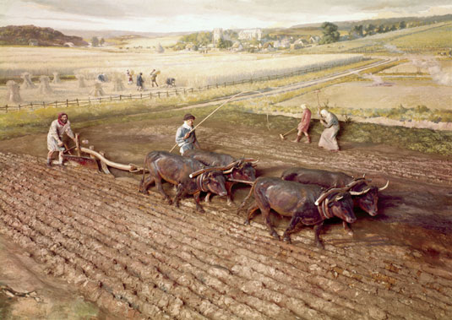

Slide 34
University of South Carolina
The General Assembly founded The University of South Carolina College on December 19, 1801
The General Assembly founded it in an effort to promote harmony between the Lowcountry and the Backcountry
Many parents wanted their children to know the basics of reading, writing, and calculating.
Sessions were usually limited to about four months between the end of harvest and the start of planting.
Ensured the political men of the Upcountry were at least educated.
South Carolina College acquired a reputation as the leading institution of the South

Slide 35
