Slide 1
Physical and Chemical Changes
Chemistry Goal 9

Slide 2
Two Types of Changes
1. Physical Changes do not change the composition of a substance, only the physical properties.
2. Chemical changes change the composition of a substance. The change results in the formation of one or more new substances with new properties.

Slide 3
How do you know if a change is physical or chemical?
LOOK FOR EVIDENCE OF A PHYSICAL OR CHEMCIAL CHANGE!!

Slide 4
Evidence: physical changes
Change in the state of matter
When a substance changes from one state of matter to another, the composition of the substance remains the same.
Deposition – when a substance changes directly from a gas to a solid
frost
Sublimation – when a substance changes directly from a solid to a gas
Dry ice or solid air fresheners

Slide 5
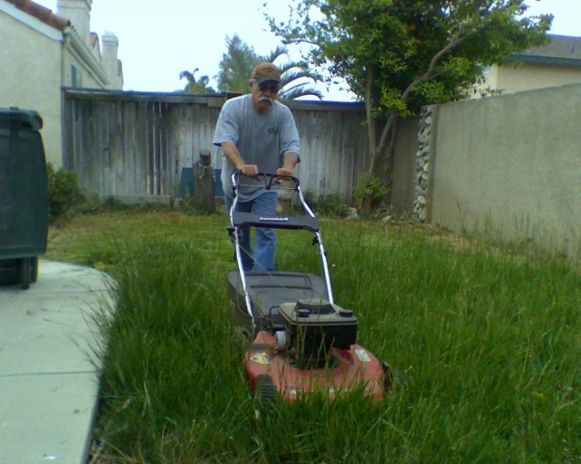
Evidence: physical changes
Change in size or shape
When a substance changes size or shape, its composition remains the same.
Examples:
Tearing/cutting paper
Mowing the grass
Chopping wood
Gluing paper together

Slide 6
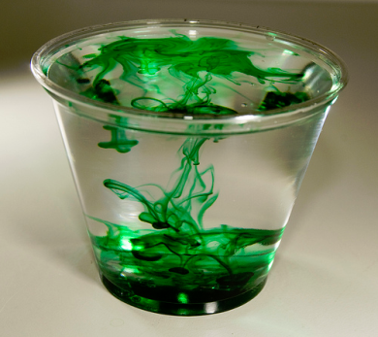
Evidence: chemical changes
Color Change:
When a substance changes color, the chemical composition may have changed.
Example: Copper turning green
It is possible to have a color change without a chemical change.
Adding food coloring to water changes its color but no chemical change has occurred.

Slide 7
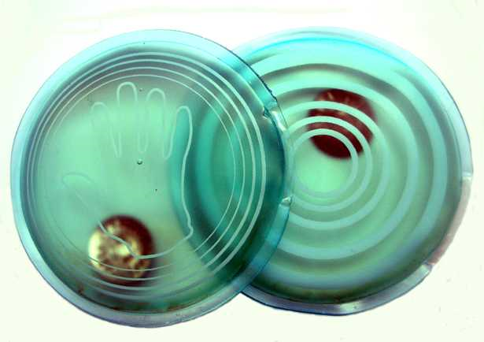
Evidence: chemical changes
Temperature change:
When a substance is combined with another substance, there may be an increase or decrease in temperature.
Example: A hand warmer
It is possible to have a temperature change without a chemical change.
When you heat water to boil it, the temperature increases but no change in composition occurs so it is not a chemical change.

Slide 8
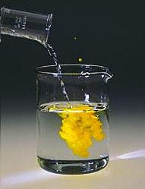
Evidence: chemical changes
Formation of Precipitate
When two solutions are combined they may form a solid substance. This solid is called a precipitate. It indicates a chemical change has happened.
The precipitate may be in the form of very small particles, which will make the solution look cloudy.

Slide 9
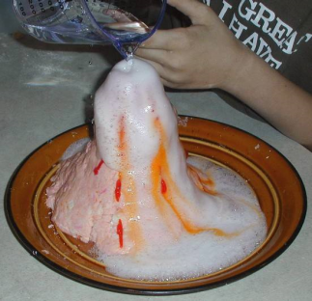
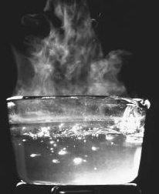
Evidence: chemical changes
Formation of a Gas
When solid or liquid substances are combined, they may form gas bubbles.
Example: Baking soda and vinegar
It is possible to form gas without a chemical change.
When boiling water, gas bubbles form but there is no change in composition so no chemical change has occurred.

Slide 10
Copy down the table on the back of your notes:
What changed? | What type of change? | Evidence? (can be more than one piece of evidence)
Tearing Paper
Burning Paper

