Slide 1
Viruses
Cell Goal 5

Slide 2
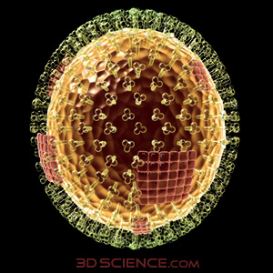
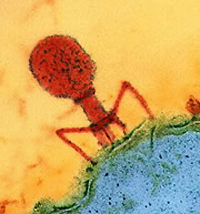
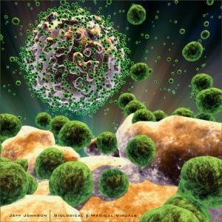
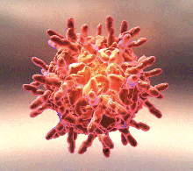
Viruses
Viruses are tiny particles much smaller than bacteria and can only be seen with a very powerful microscope.
HIV
Rhinovirus (Common Cold)
Influenza
T4 Bacteriophage infecting a cell

Slide 3
Are they alive?
In isolation, viruses show none of the expected signs of life. They do not respond to stimuli, they do not grow; they do not do any of the things we normally associate with life. Therefore, they should not be considered as living organisms at all.

Slide 4
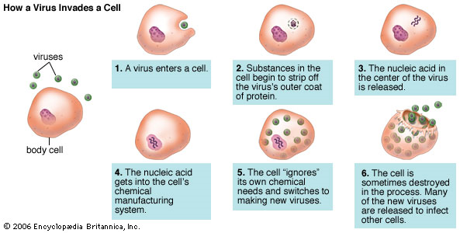
However, viruses do show one of the most important signs of life: the ability to reproduce.
Viruses are considered to be nonliving until they infect the cells of a host plant or animal and reproduce within those cells.

Slide 5
Viruses are responsible for causing many diseases in living organisms.
AIDS
Rhinovirus (common cold)
Influenza (the Flu)
Varicella (chicken pox)
Human papillomavirus (warts)
There is no “cure” to a viral infection

