Slide 1
Classifying Matter
Chemistry Goal 5

Slide 2
Matter is classified based on its composition (what it is made of)
All matter can be classified into 3 groups:
Elements
Compounds
Mixtures

Slide 3
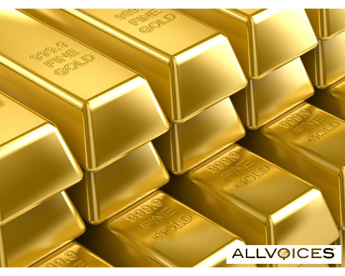
Elements
Pure substances that cannot be changed into simpler substances.
Elements are composed of 1 kind of atom.

Slide 4
Compounds
Pure substances that are made of 2 or more types of elements that are chemically combined.
Can only be changed into simpler substances called elements by chemical changes.

Slide 5
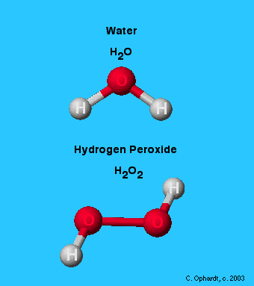
Molecule – is formed when 2 or more atoms combine. The smallest form of a compound.

Slide 6
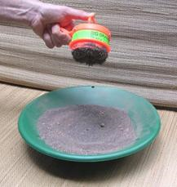
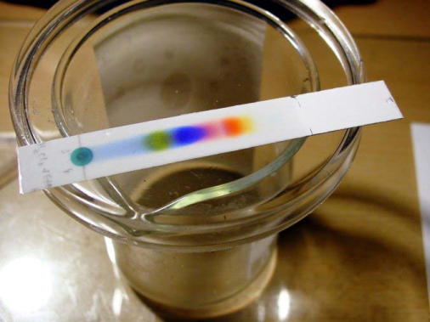
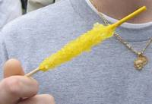
Mixtures
Made of 2 or more different substances that keep their own properties and are combined physically (mixed together)
Can be separated by physical means:
Filtering, Sifting, Magnetic attraction, Evaporation, Chromatography, Flotation

Slide 7
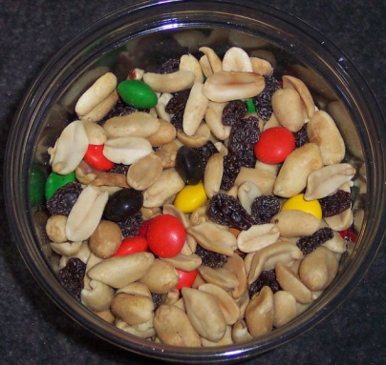
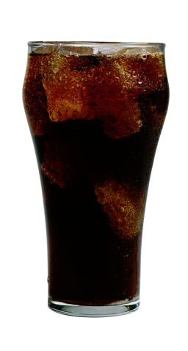
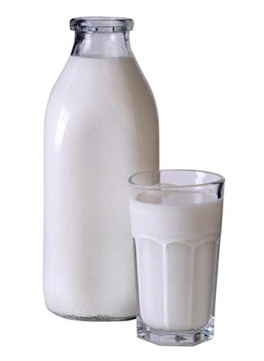
Two types of mixtures:
Heterogeneous Mixture – not uniform through out; the component substances can be visibly distinguished.
Example – Trail Mix
Homogenous Mixture – uniform throughout; the substances are evenly mixed and cannot be visibly distinguished. Another name for a homogenous mixture is a solution.
Example – soda or milk

Slide 8
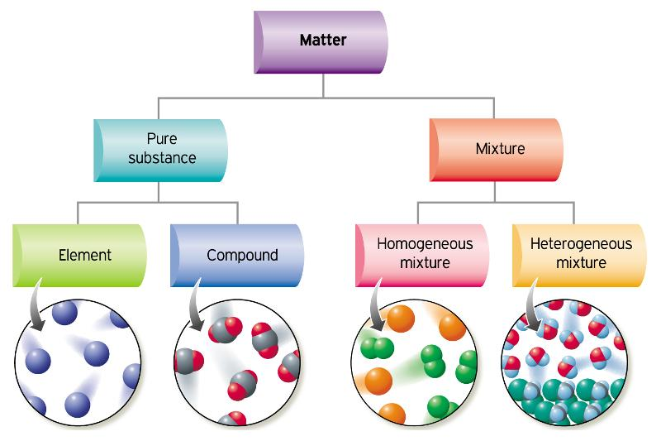
Flow Chart/Illustration of Atoms

