Slide 1
Metals and Nonmetals
Chemistry Goal 4

Slide 2
COPY THE TABLE IN NOTES
Metals | Non-Metals
Luster- shiny | Dull- not shiny
Conductor- electricity runs through it well | Non-conductor- electricity does not run through it well
Malleable- can be hammered down into different shapes | Brittle- breaks easily
Ductile- ability to be made into a wire
High Density- heavy for its size

Slide 3
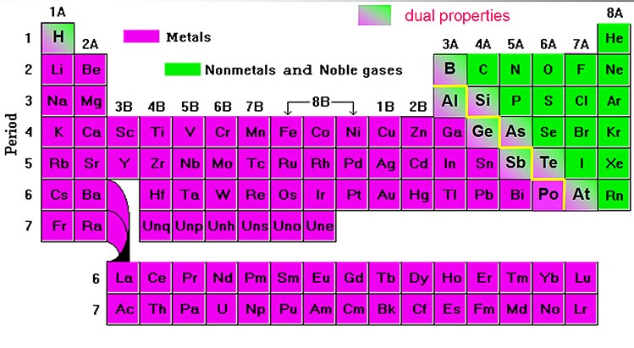
Metals and nonmetals are two major groups of elements that have different physical properties.

Slide 4
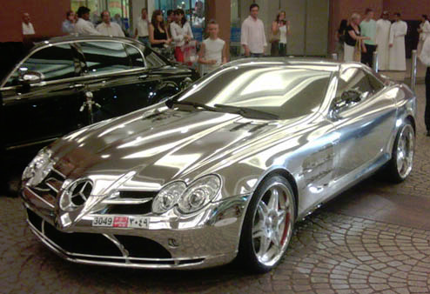
Metals – physical properties
Luster – having a shiny surface or reflecting light brightly

Slide 5
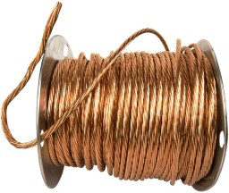
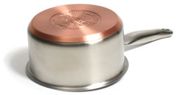
Metals – physical properties
Conductor – heat and electricity move through them easily

Slide 6
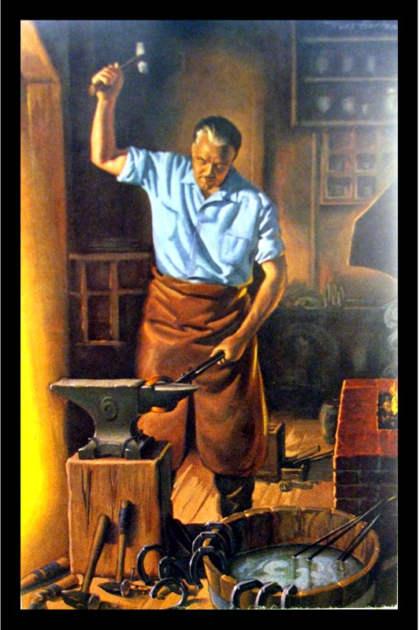
Metals – physical properties
Malleable – ability to be hammered into different shapes

Slide 7
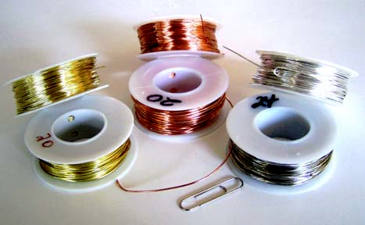
Metals – physical properties
Ductile – Ability to be made into a wire

Slide 8
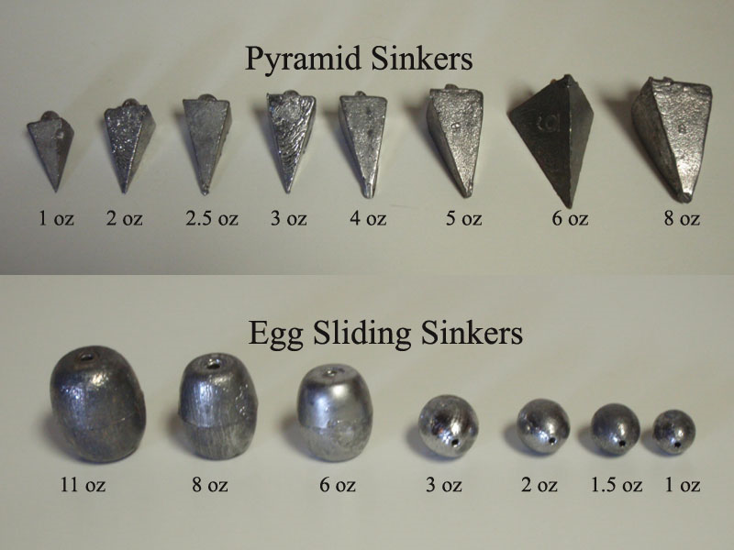
Metals – physical properties
High Density – heavy for their size.

Slide 9
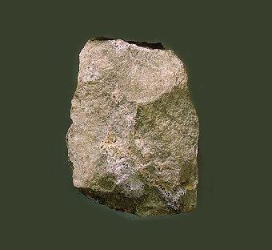
Nonmetals – physical properties
Dull – not shiny

Slide 10
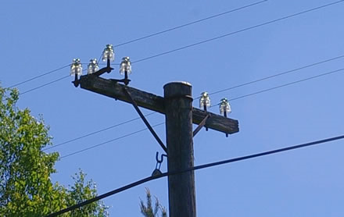
Nonmetals – physical properties
Nonconductors – heat and electricity do not move through them easily

Slide 11
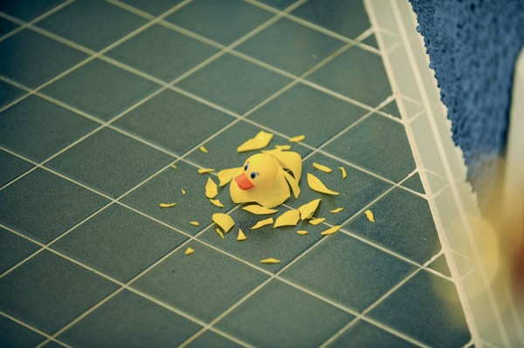
Nonmetals – physical properties
Brittle – Break or shatter easily (solids)

