Slide 1
What We Did Yesterday
What is a Joint-Stock Company?
The Mid-Atlantic Region was also known as?
What is the Head-Right System?
These people were granted South Carolina for helping the king get his throne back?
The first governing document of Plymouth Colony?
The first boom town in America was?

Slide 2
Settlements of The United States
New England
Mid Atlantic
South

Slide 3
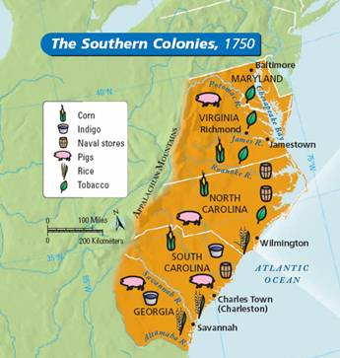
Southern Colonies

Slide 4
Jamestown
In 1607 Jamestown became the first permanent English settlement in the New World.
The settlers endured several years of starvation and the deaths of many until tobacco made the settlement sustainable
The London Company initiated the Headright System which provided land to anyone who paid their own passage or the passage of others to the settlement.
Tobacco growers enlarged their land holdings through the headright system and secured workers by paying for the passage of indentured servants.

Slide 5
Jamestown
In 1619 The London Company established the House of Burgesses so settlers would have a voice in the way the colony was being governed.
By the end of the 1600’s English plantation owners turned to a more reliable source of labor African slaves.
Jamestown grew into the colony of Virginia and established a pattern for the Southern colonies.

Slide 6
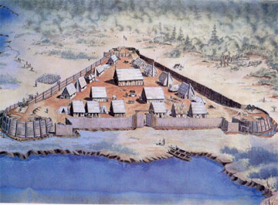

Slide 7
South Carolina
It was founded as a proprietary colony when the king granted land to the eight Lords Proprietors as payment for helping him get the throne back.
They hoped to make a profit by charging settlers a tax on the land they were living.
Like Virginia they encouraged immigration by granting large plots of land to settlers through the headright system.
The headright system led to the establishment of large plantations based on cash crops which distinguished South Carolina itself as a great southern colony.

Slide 8
South Carolina
The first settlers were Englishmen who immigrated from the British colony of Barbados and brought a well-developed slave system with them.
The South Carolina colony’s natural resources included fertile land, a mild climate, and many waterways.
Originally the Lords Proprietors controlled the government through a Governor and Grand Council with representatives from
The Proprietors
The Carolina elite
Common people of the colony

Slide 9
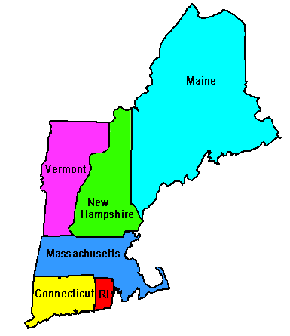
New England Colonies

Slide 10
New England Colonies
Founded as a haven for religious groups persecuted in England.
In 1620 after signing the Mayflower Compact the Pilgrims landed at Plymouth Rock and established another bedrock of American democracy.
Mayflower Compact- The first governing document of Plymouth Colony.
With the help of a Native American they learned how to plant corn and sustain themselves.

Slide 11
Massachusetts
In the 1630’s a large group of Puritans landed in Massachusetts.
They established a democratic form of government that included town meetings and a general assembly.
Established schools so their children could learn to read the Bible and established religious conformity.
Harvested lumber from the northern woods.
Built ships
Engaged in trade

Slide 12
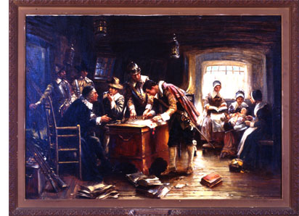

Slide 13
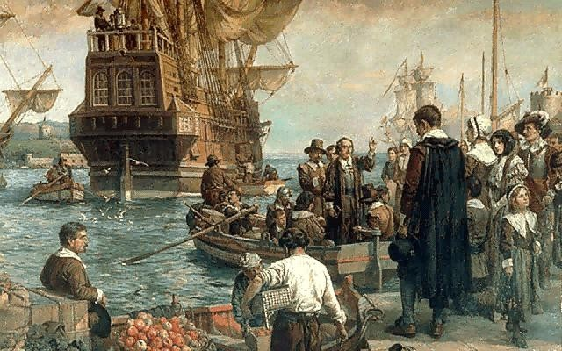

Slide 14
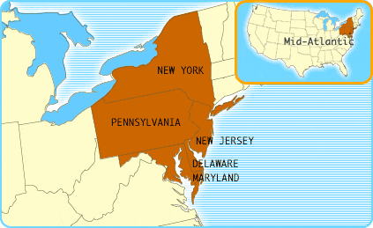
Mid Atlantic Colonies

Slide 15
Middle Colonies
Also known as the “breadbasket” of the colonies
Founded for the purpose of profit because it rested on good harbors and fertile fields.
Included a great variety of Europeans such as the Dutch, Swedes, English Puritans, Quakers
They had the greatest diversity of people and religions in British North America.
Quakers promoted religious tolerance and good relations with the natives in their region.

Slide 16
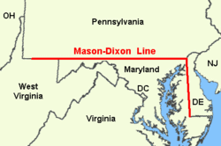

Slide 17
Video Clip
Jamestown-http://www.youtube.com/watch?v=vpA5O46Ioyk

